Slide 1
Nisha Patel

Slide 2
QA topics covered
Agile
Scrum is a framework within which people can address complex problems.
Database is collection of data tables, queris,schema.
Networking
Java -2 weeks
Risk Management

Slide 3
Objective of Project
The individual project completed by me was to build an application that an end user can interact with via a CLI (Command Line Interface). The application is an inventory management system which is able to add/view/update/delete customer to the system. Same with items in the systems. In addition, it also has features such as calculates cost of an order, update the quality of an item in a order and the total cost of order that exceed 10000 bulk get 10% discount is applied to the order.

Slide 4

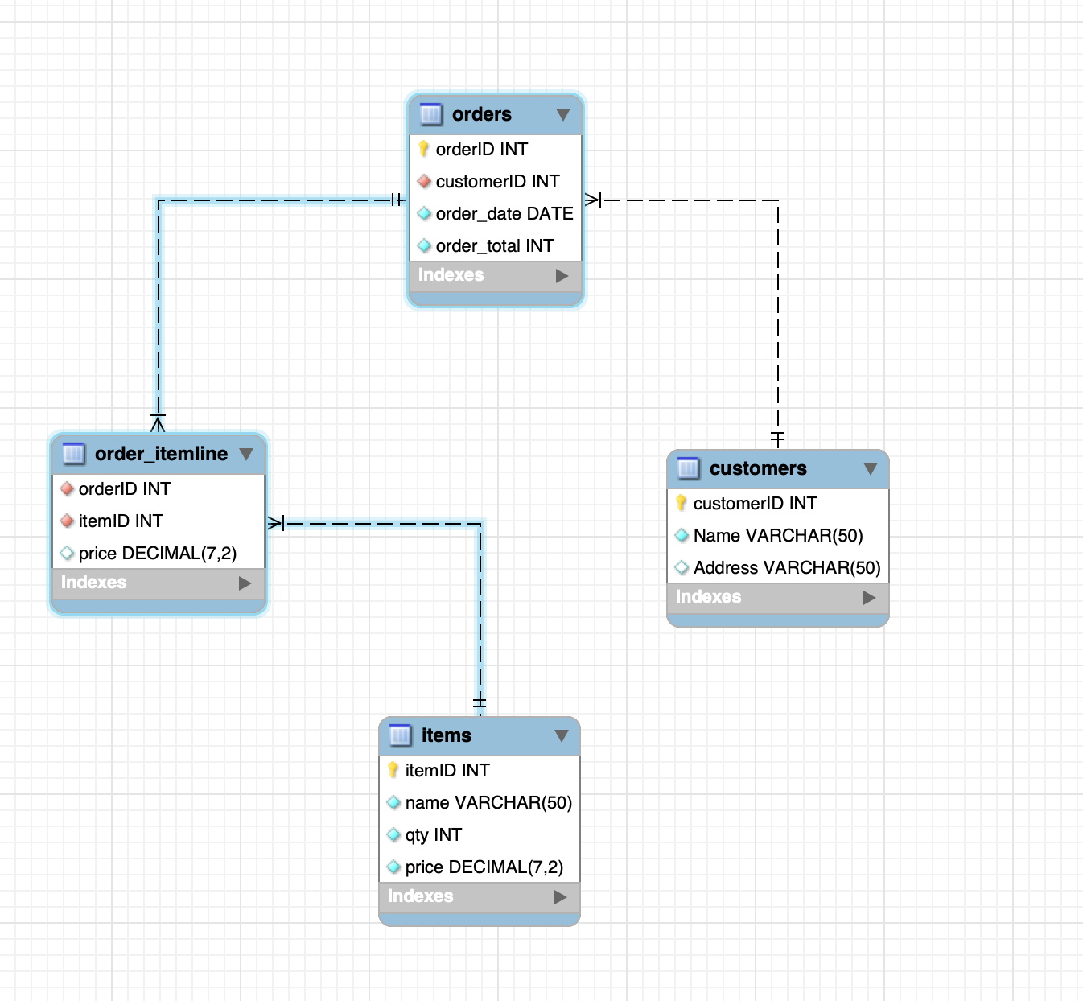
SQL ERD DIARGRAM
I created my SQL statements a relational database used to store data persistently for the project, this database had my customer, order, item to demonstrate the relationship between them

Slide 5
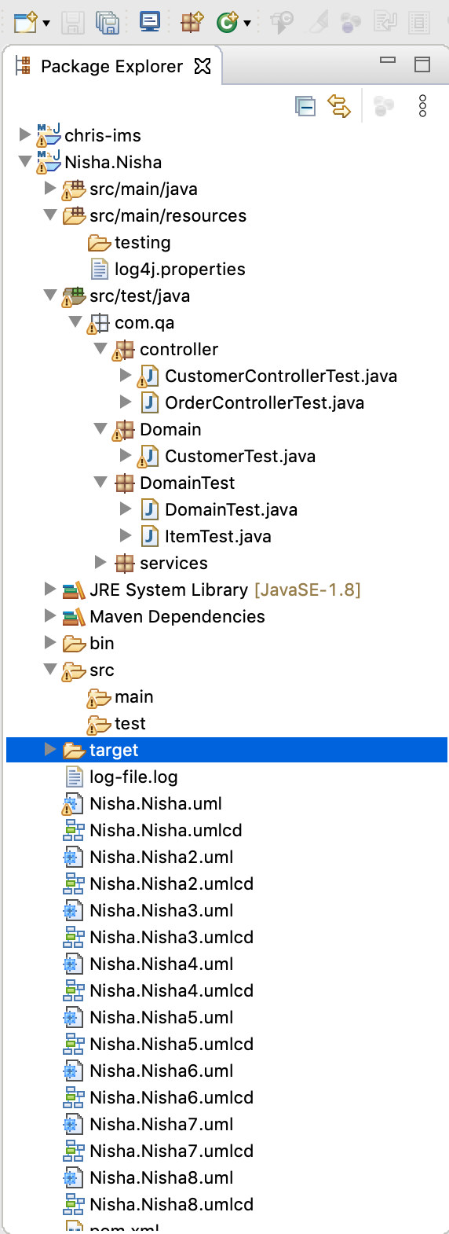
Java packages and classes
This are all the packages and classes I have for my project

Slide 6
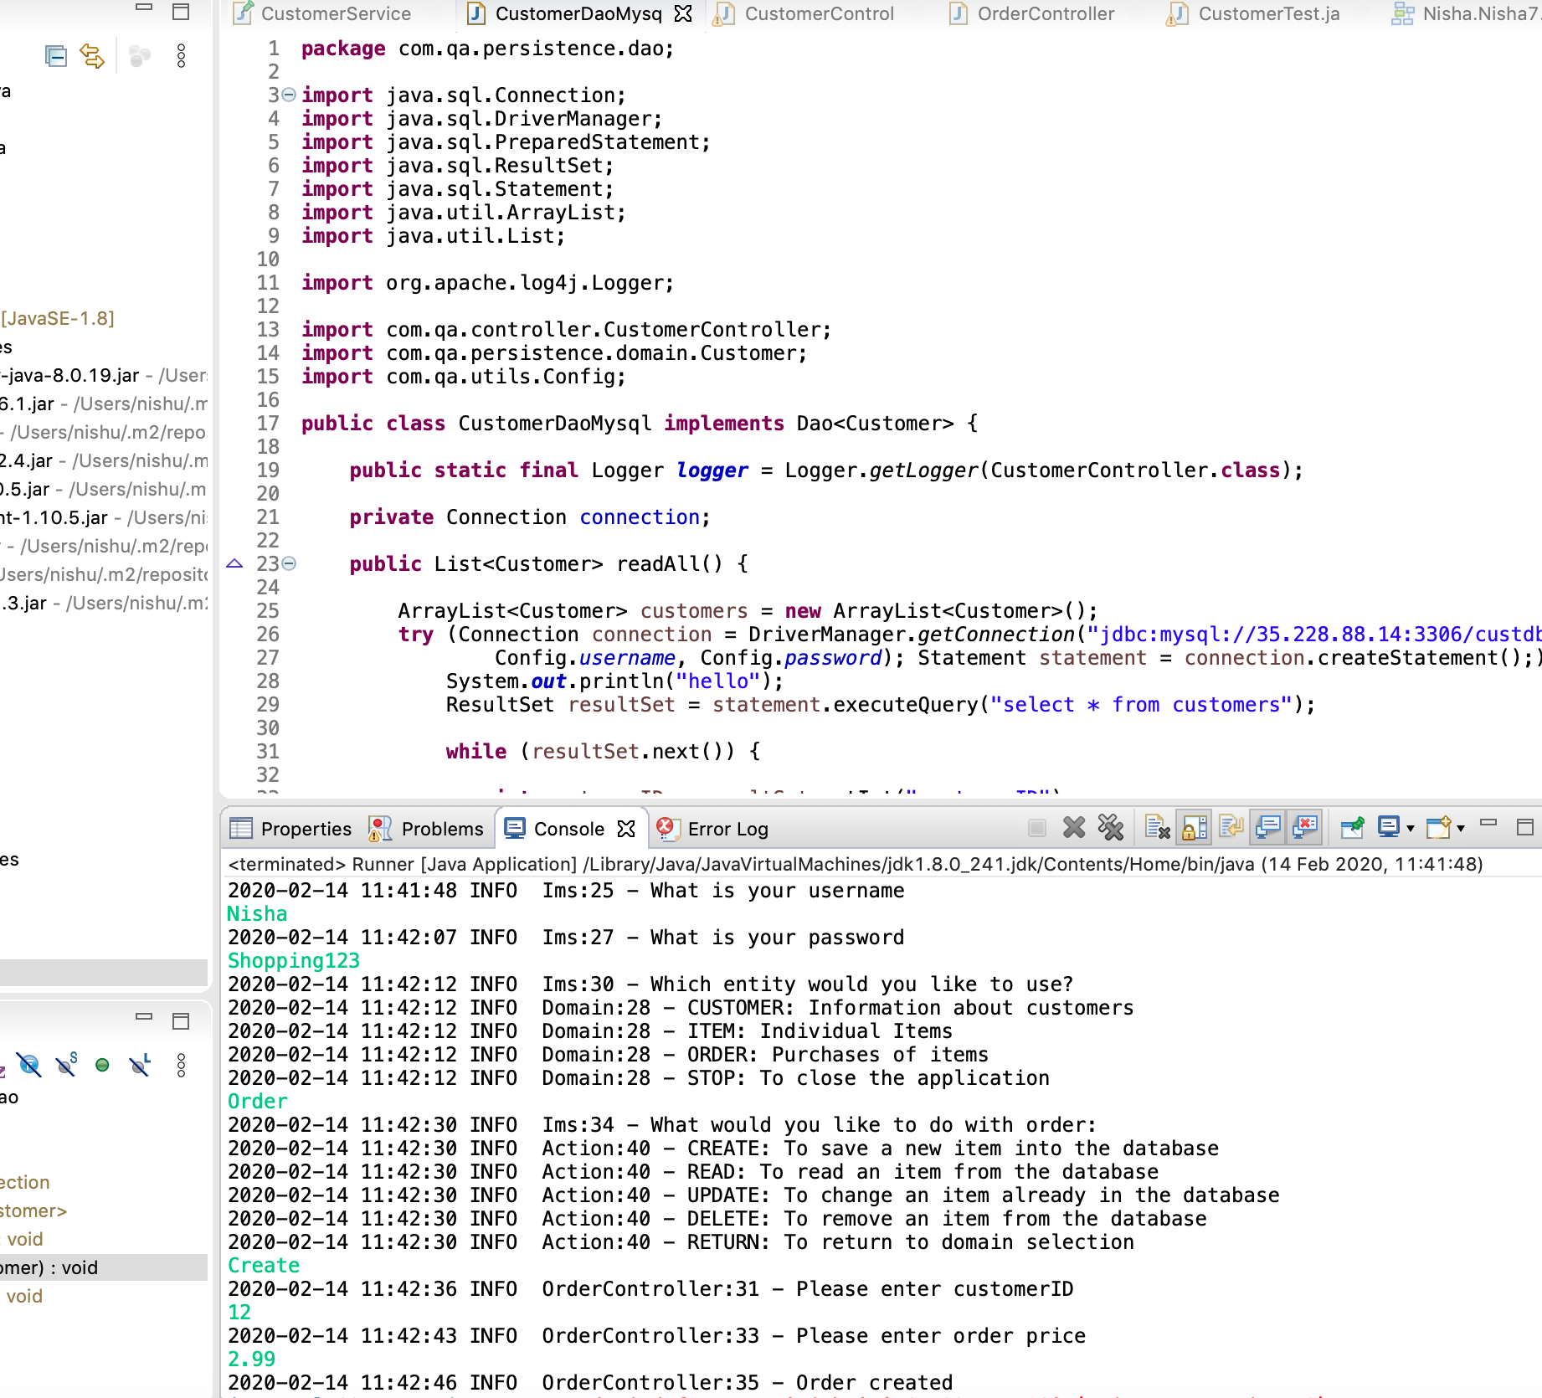
CustomerDaoMyql Class
This screenshot show orders are created and added to the SQL query's

Slide 7


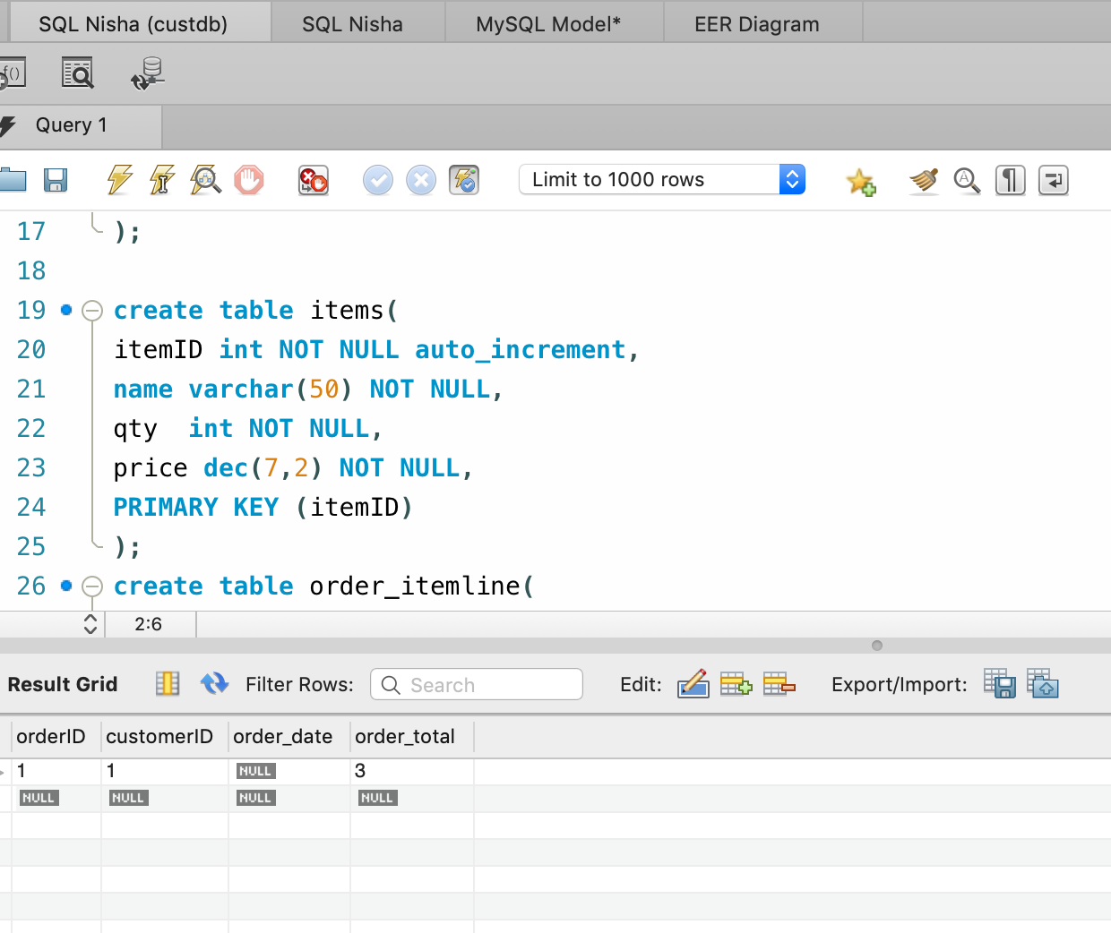

In SQL order is created

Slide 8
Testing
Test all the classes
Jenkins
SonarQube

Slide 9
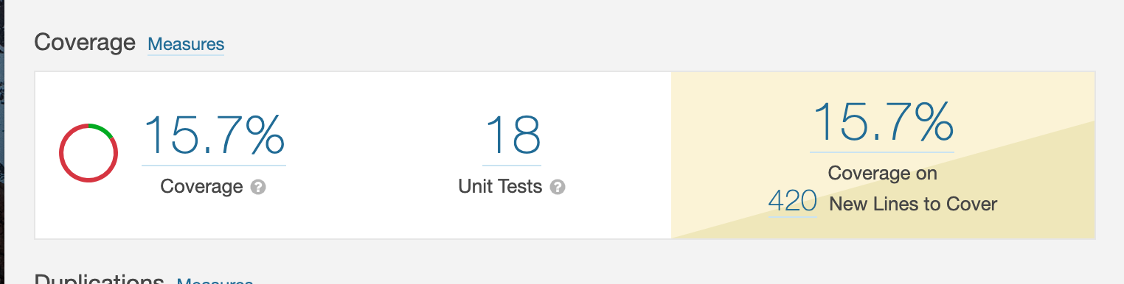
SonarQube Test Coverage

Slide 10
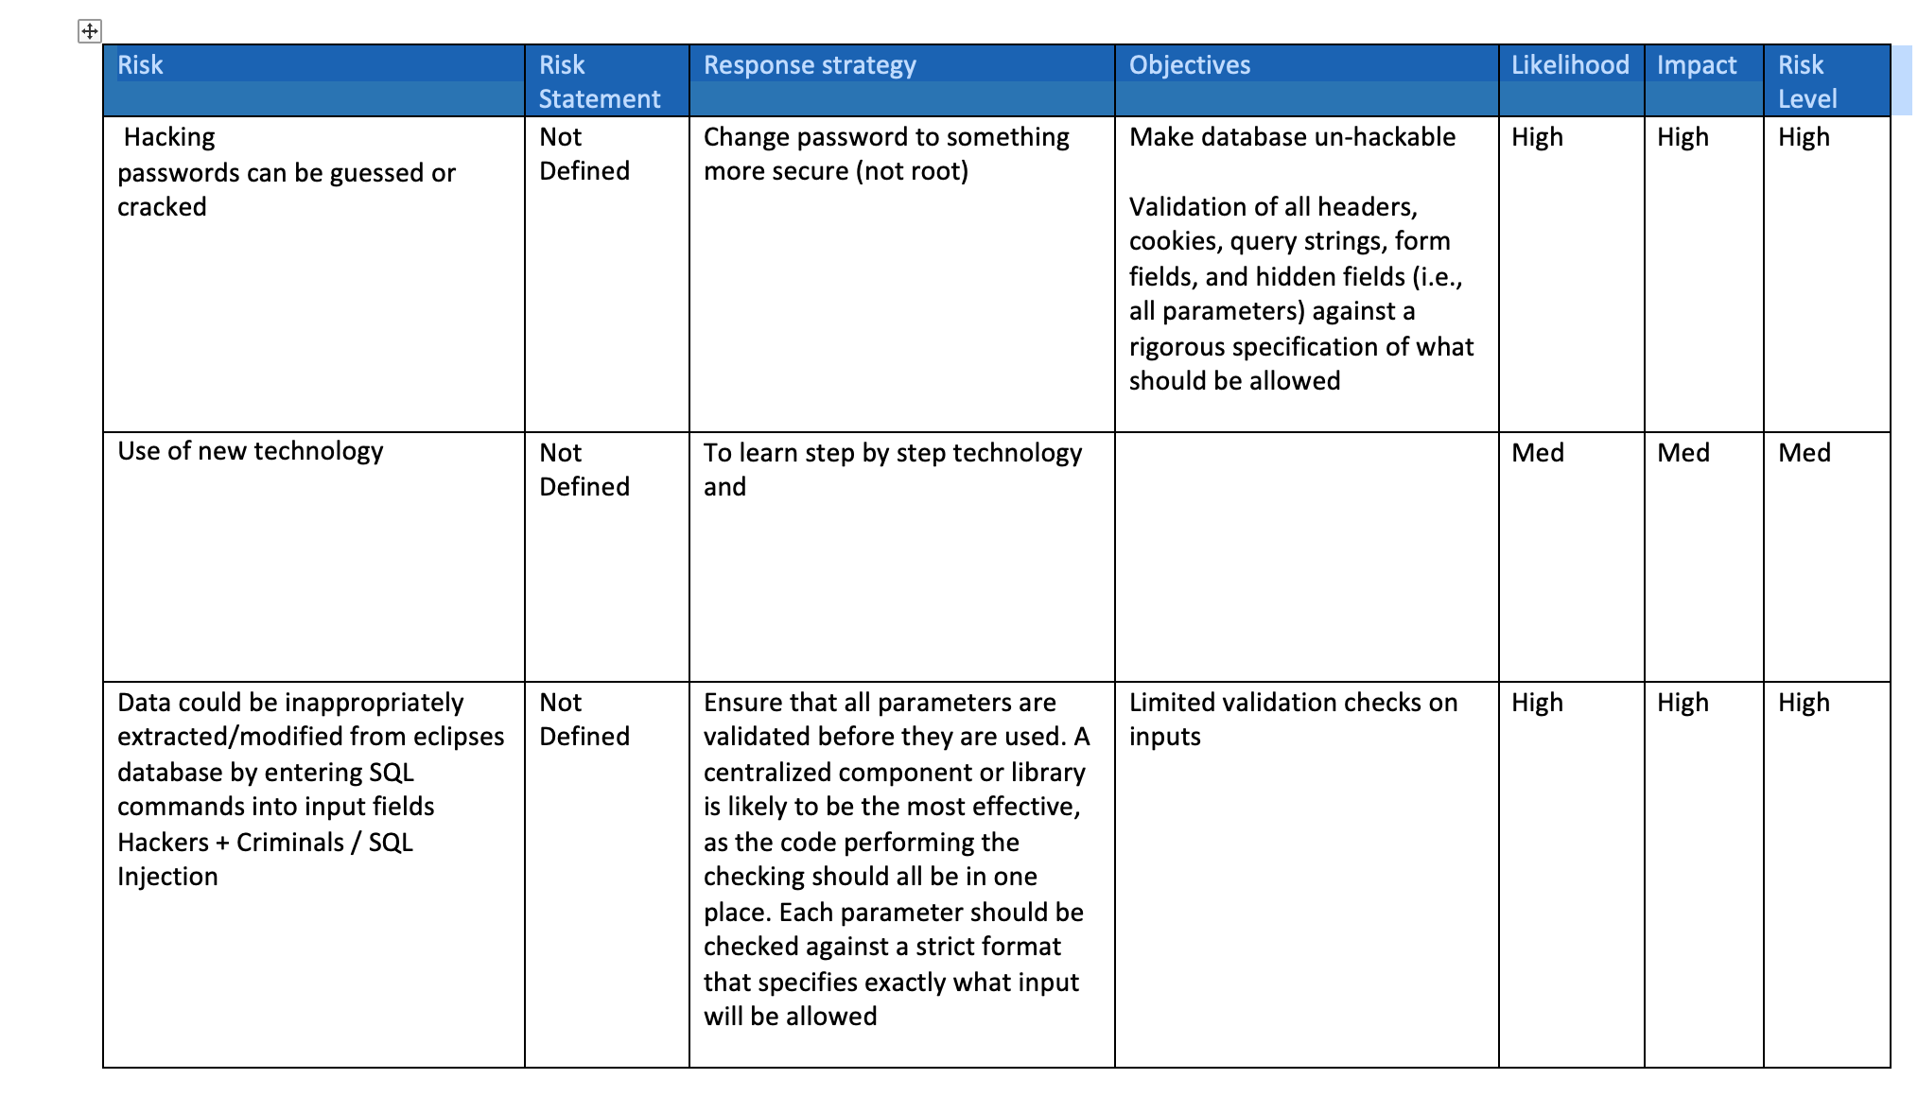
Risk Management

Slide 11
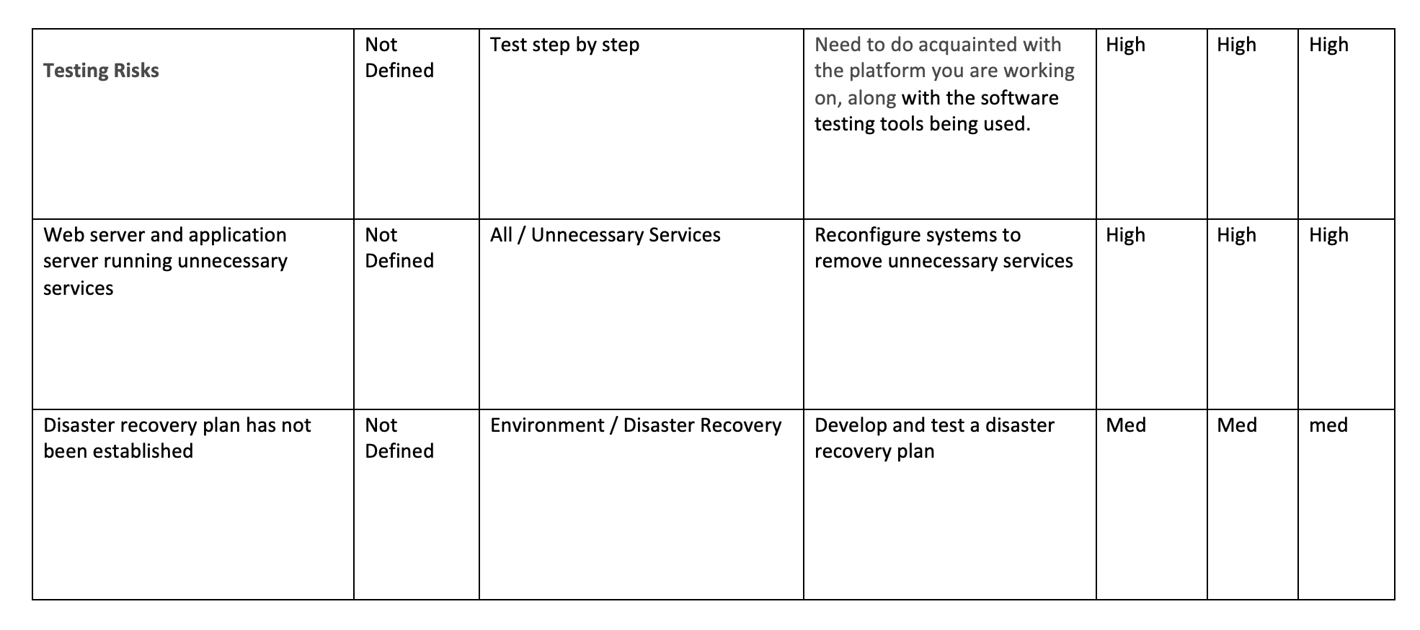

Slide 12
Thank you

